Slide 1

Chirp
Twitter Sentiment Analysis

Slide 2
Project Overview
Chirp is a website that provides data visualizations of user sentiment and language over time for a specific company. It also displays current news about the company.
Manifesto:
Software that helps both companies and consumers to understand the effect of a company’s recent events on the public’s perception of the company. This software will help companies strategize when releasing a new product/service or understand the impact a recent scandal had on their public perception. The software will also help consumers of tech companies understand the public’s opinion of those companies.

Slide 3
Roles & Responsibilities
Role | Assigned Person
Development Lead | Alex Supkay
Developer(s) | Kyle Rozanitis, Alex Supkay, Pratik Shah, Siddhart Lapsiwala
Architect(s) | Kyle Rozanitis, Alex Supkay, Pratik Shah, Siddhart Lapsiwala
Test Lead | Siddhart Lapsiwala
Tester(s) | Kyle Rozanitis, Alex Supkay, Pratik Shah, Siddhart Lapsiwala
Product Champion (Customer Representative) | Pratik Shah
Documentation | Kyle Rozanitis
Risk Management | Alex Supkay

Slide 4
Repositories
All of our code and documentation is stored in this GitHub repo: https://github.com/Asupkay/Chirp

Slide 5
Development Plan
Process:
Agile Scrum
Languages:
JavaScript, Node.js, JSX, CSS
Packages:
Express, React, Sentiment (Sentiment Analysis), Franc (Language Analysis), Iso-Converter (Convert ISO 639-3 codes to Plain Text English), News API (News Aggregator), Socket.IO, Firebase API,Twitter Real-time filter API
Database:
Firebase Realtime Database
Infrastructure
Google Cloud Compute Engine, NGINX

Slide 6
Development Plan
Early on, our team decided that the best course of action would be to split the team into two individual scrum teams:
Frontend (Sidd, Pratik)
Backend (Alex, Kyle)
Shortly after our first code review, when the framework for the website had been created and sentiment and language data was successfully being stored in Firebase, we switched the responsibilities so that Kyle and Alex began working on the frontend and Sidd and Pratik began working on the backend.
During the semester, both teams created separate branches (frontend and backend), worked on the agreed functionality, and committed only to those respective branches.

Slide 7
Development Plan
Prior to switching roles, both scrum teams modularized their code and added comments.
The sub-branches were then merged back to the master branch and broken off again.
During the semester, two code reviews took place where both teams presented to their colleagues their current progress for the most recent sprints.
Both teams also pair programmed often throughout the semester.
Our team utilized Slack and met every Thursday after-class. Additionally, both scrum teams met on their own time to continue working.

Slide 8
Demo (Screenshots)

Slide 9
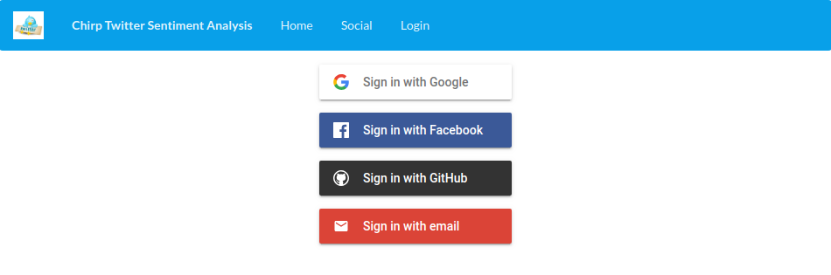

Slide 10
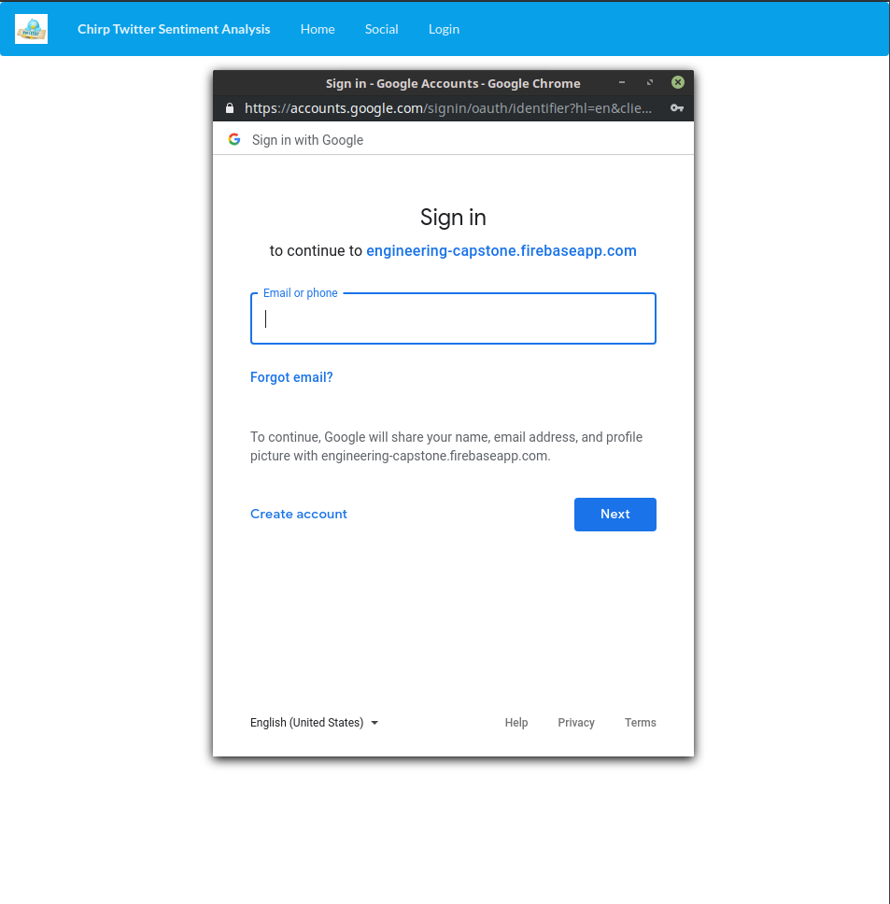

Slide 11
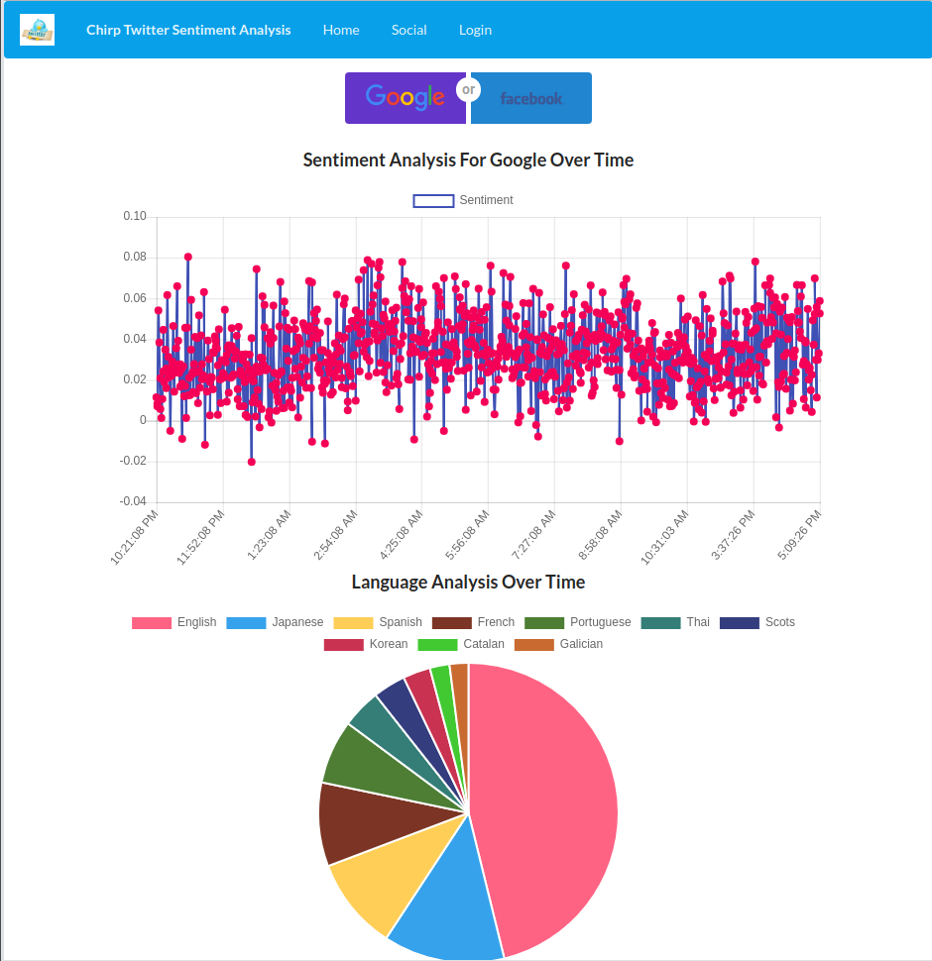

Slide 12
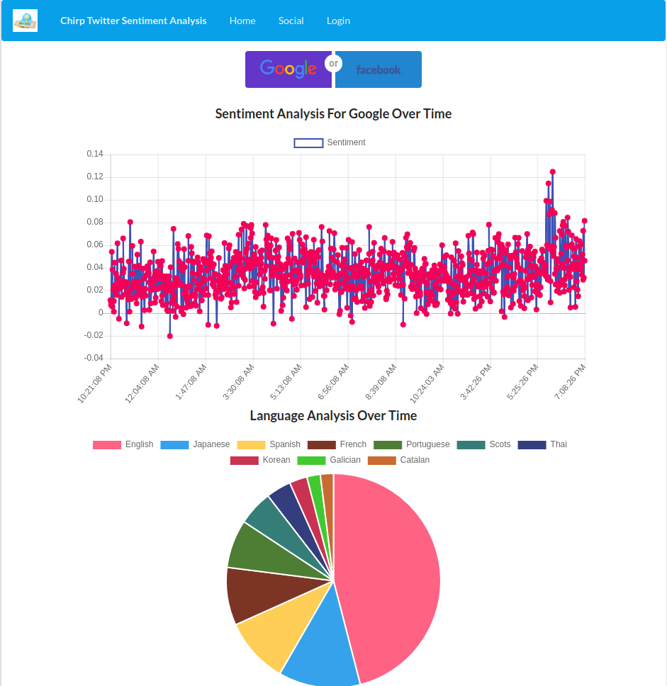

Slide 13
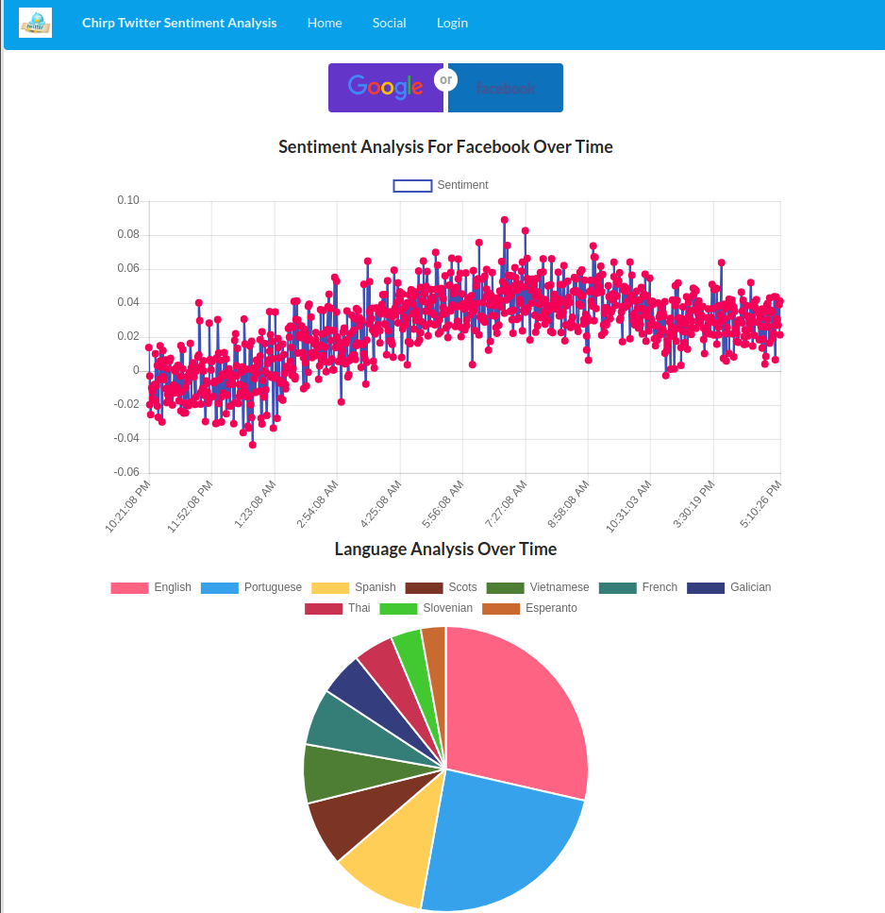

Slide 14
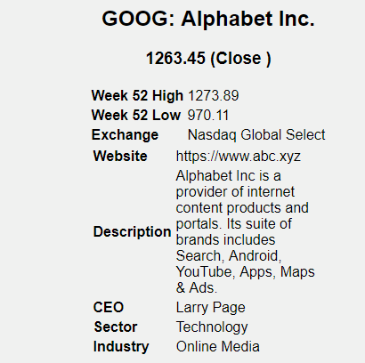

Slide 15
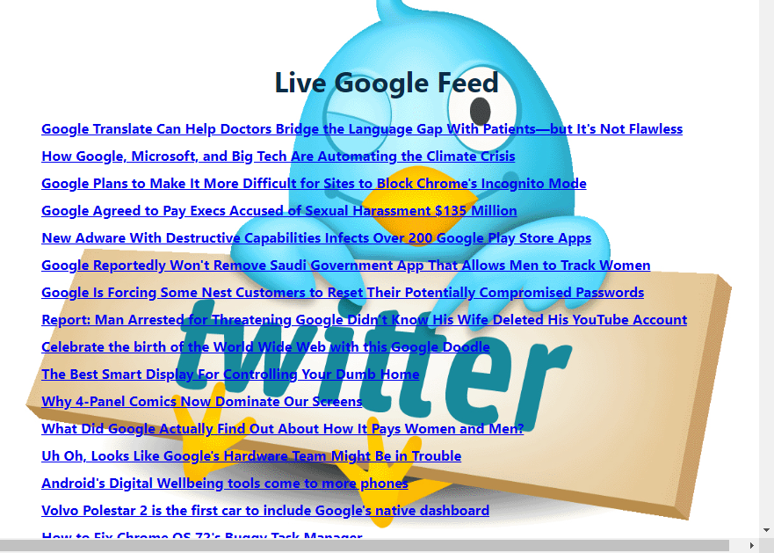

Slide 16
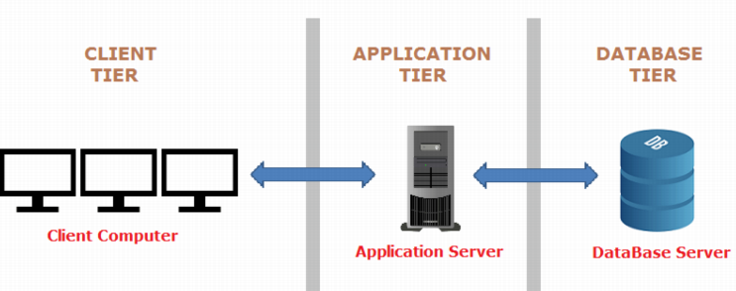
Architecture
Three-Tier Architecture

Slide 17
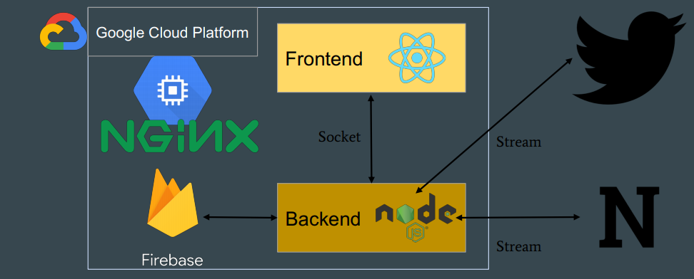

Slide 18
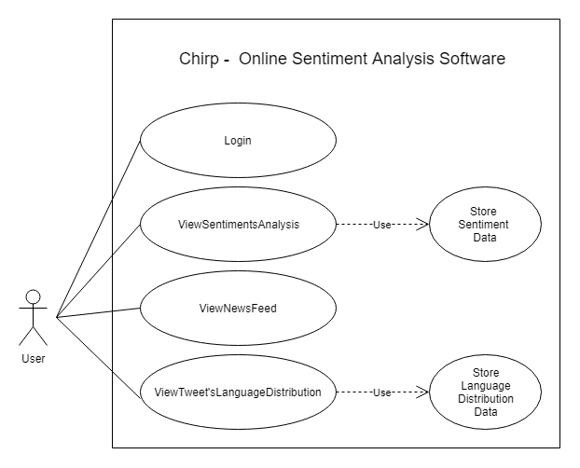
Use Cases/User Scenarios

Slide 19
Metrics - Tool Selection
Since our team built a web application using JavaScript instead of Python, we were forced to look for an alternative to Radon to measure the maintainability, cyclomatic complexity, and other raw metrics of our source code.
After experimenting with VS Code Extensions and various online static analysis tools, we settled on Plato, an open-source code visualization, static analysis, and complexity tool.
Plato utilizes a node module, complexity-report, to generate a report with various metrics and statistics of our source code.
The reasons we chose this tool were usability and performance; the tool was installed using npm, can be executed from the command line, and generates easy-to-interpret reports.

Slide 20
Metrics - Overview
Below is a list of the files that Plato analyzed:
Frontend | Backend
Chart_App.js, chart.js | app.js
Dashboard.js, priorityQueue.js | database.js
Login.js | news.js
NavBar.js | streams.js
Client.js (Newsfeed)
pie.js

Slide 21
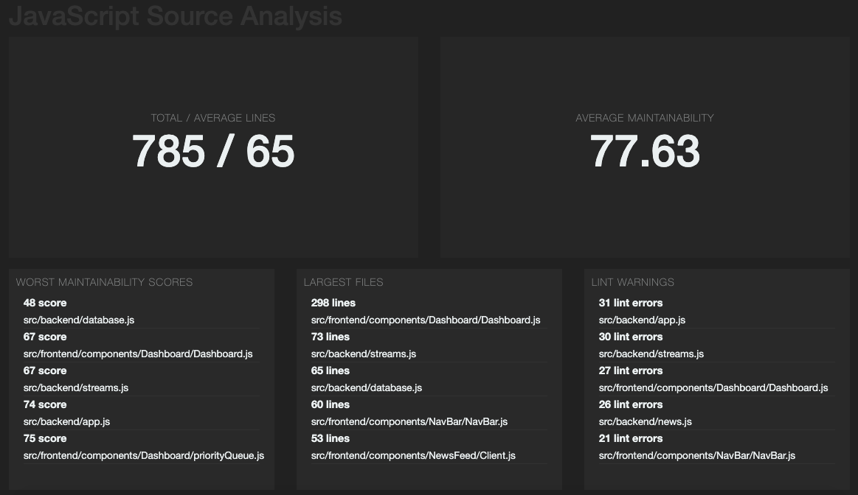
Metrics - Dashboard

Slide 22
Metrics - Maintainability
The Maintainability Index for Plato ranges from 0-100 instead of the usual 171 and lower because the team believed that the difference between 0 and some negative value was not very useful and any code that approaches 0 is already clearly hard to maintain.
The thresholds are broken down from 0-100 in an 80-20 split to keep the noise level low and only flag code that was really suspicious.
Therefore:
0-9 = Red
10-19 = Yellow
20-100 = Green

Slide 23
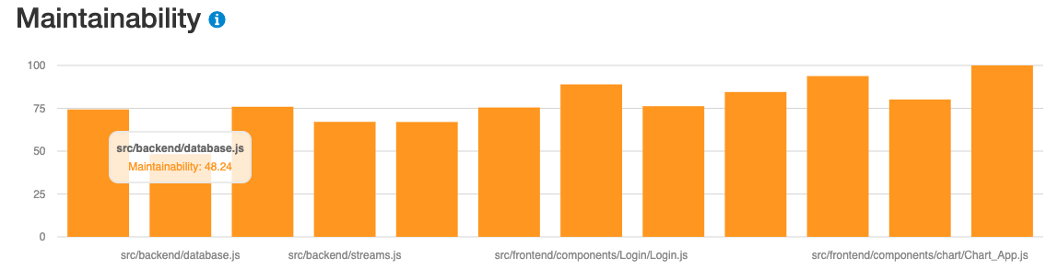
Metrics - Maintainability
Based on the data in the chart above, database.js, which is the file that is responsible for saving and retrieving the sentiment, language, and news data from the Firebase Database, has the lowest maintainability score at 48.24.
The second lowest is Dashboard.js at 66.99.
The highest maintainability is chart.js at 100.

Slide 24
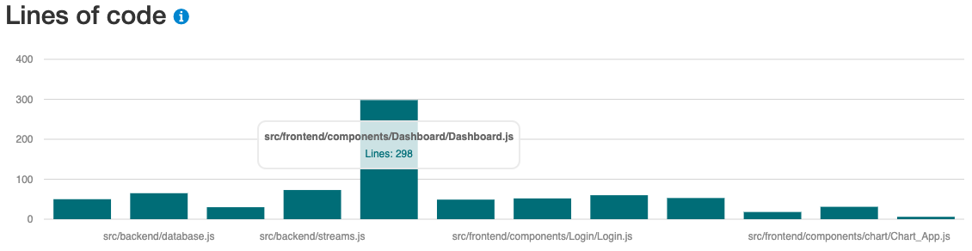
Metrics - Lines of Code
Another important metric that can affect the maintainability is lines of code (LOC). Based on the above chart, Dashboard.js, which if you remember had the second lowest maintainability rating, has 298 LOC. This number is substantially higher than the average 65 LOC and is a large driver of the high maintainability score.
chart.js, on the other hand, only has 6 LOC.

Slide 25
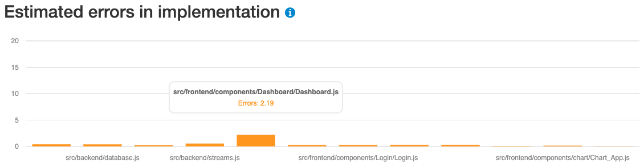
Metrics - Estimated Errors in Implementation
Estimated Errors in Implementation, or the Number of Delivered Bugs, is a Halstead Maintainability Metric that can be calculated by dividing the volume (a measure of the size of a piece of code) by 3000.
Dashboard.js, which had the highest LOC and second highest Maintainability score, has the highest estimated number of delivered bugs at 2.19.
The remainder of the files estimated less than 0.56.

Slide 26
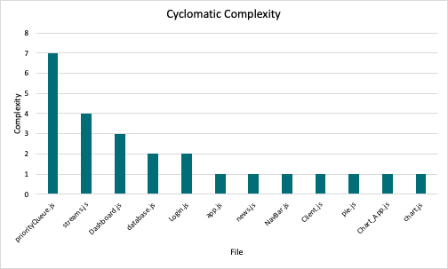
Metrics - Complexity
The above chart shows that the file with the highest cyclomatic complexity is priorityQueue.js with a score of 7 while majority of the files have a score of 1.
A score less than 10 usually indicates that the code is relatively easy to maintain so based on this metric, our code is not too complex.

Slide 27
Backlog
Week | Log
Week 1 | Finalized project topic in class Explored more ideas about the project
Week 2 | Created a repository on GitHub and finalized the MVP for our project. Worked on the architecture and development plan
Week 3 | Developed Login component Began streaming tweets & filtering for English tweets Began analyzing tweets and identify language of tweets Configured Firebase
Week 4 | Developed real time graph for Bitcoin data Refactored architecture Wrote code to store sentiment & language data in the DB Created room using socket.io for communication

Slide 28
Backlog (cont.)
Week | Log
Week 5 | Developed News Feed component Wrote code to retrieve sentiment & language from Firebase
Week 6 | Developed Pie chart component Integrated all the frontend components (Login, News Feed, Bitcoin and Pie chart) Changed the data structure in firebase to store data for different companies Modularized code and added comments Added authentication to database
Week 7 | Explored more ideas with professor and discussed areas to work on for rest of the semester

Slide 29
Backlog (cont.)
Week | Log
Week 8 | Spring Break
Week 9 | Integrated frontend and backend
Week 10 | Refactored code module/component wise Started analyzing sentiments for 2 companies at a time Wrote backend code to save news in database instead of stream from News API
Week 11 | Storing News Feed for 2 companies at a time Began showing historic & real time sentiment data on frontend Began displaying historic & real time language count on pie chart Added priority queue to only show top 10 languages
Week 12 | Worked on the Stock component Started working on presentation

Slide 30
Next Version
Deferred User Stories (Product Backlog)
More companies and displaying sentiments in same graph for more detailed comparison.
Generate reports in excel.
Other
Automation testing framework
Implement CI/CD pipeline.
Docker Containers

Slide 31
Post Mortem
Would adopt differently for next version:
Small sprints and fix work items during sprint
More frequent meetups and communication during sprint.
More mature Git process throughout the project.
Keep Doing:
Good choice of tools(React,firebase db,GIT,etc)
Dividing task among frontend and backend.
Switching developers among frontend and backend(all developers have knowledge full application.).

Slide 32
Future Work
This project has a good foundation for any team who wants to work on Twitter sentiment analysis. The functionalities are modularized and easy to understand.
Some of the interesting functionalities for future work:
Comparing sentiment values for more than 2 companies in same chart
Displaying updated highest and lowest sentiment value for each company
Displaying the tweet that is analyzed of having highest or lowest sentiment value.
Displaying sentiment values on the chart for a day, week, month or year
Sharing the sentiment value score on social media
Some of these functionalities require Premium Twitter Developer account.

Slide 33
The Course
What was the most valuable?
Working on latest technologies in team with deadlines (Demos)
Learning projects of other teams
What was the least valuable?
An extra week before Demo 2 would be helpful as we found it difficult to work on proposed architecture as it was frequently changing with the change in requirements
What would you keep?
Mid course evaluation and demos
What would you change?
Assignment to calculate code complexity and working on metrics

Slide 34
Thank you!

